Slide 1


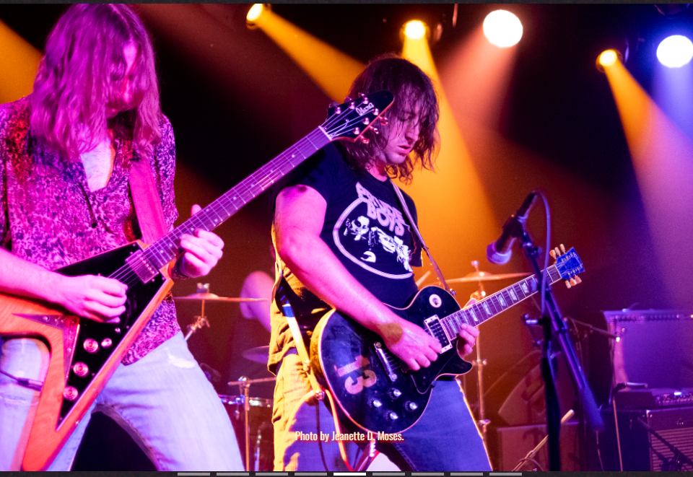
The client, a rock band called Bayaz (buy-as), is band preparing for their first ever release. Though they have accounts on social media platforms, they have no official website! The task is for the team is to outfit Bayaz with a maintainable site to act as a hub for all musical releases, show schedules, photos, and videos.

Slide 2


Our MVP
Bayazband.com
Created in ReactJS / Deployed w/ Netlify
Integrate with Songkick to show Performance Schedule
Easy-to-Access Assets (Bio, Stage Plot) for Promoters and Labels
Photo Gallery Carousel
Central location for Spotify, Facebook, Instagram, and other Social Accounts
Video Section in which selected video renders in a modal pop-up
Embedded Music Player from Bandcamp

Slide 3
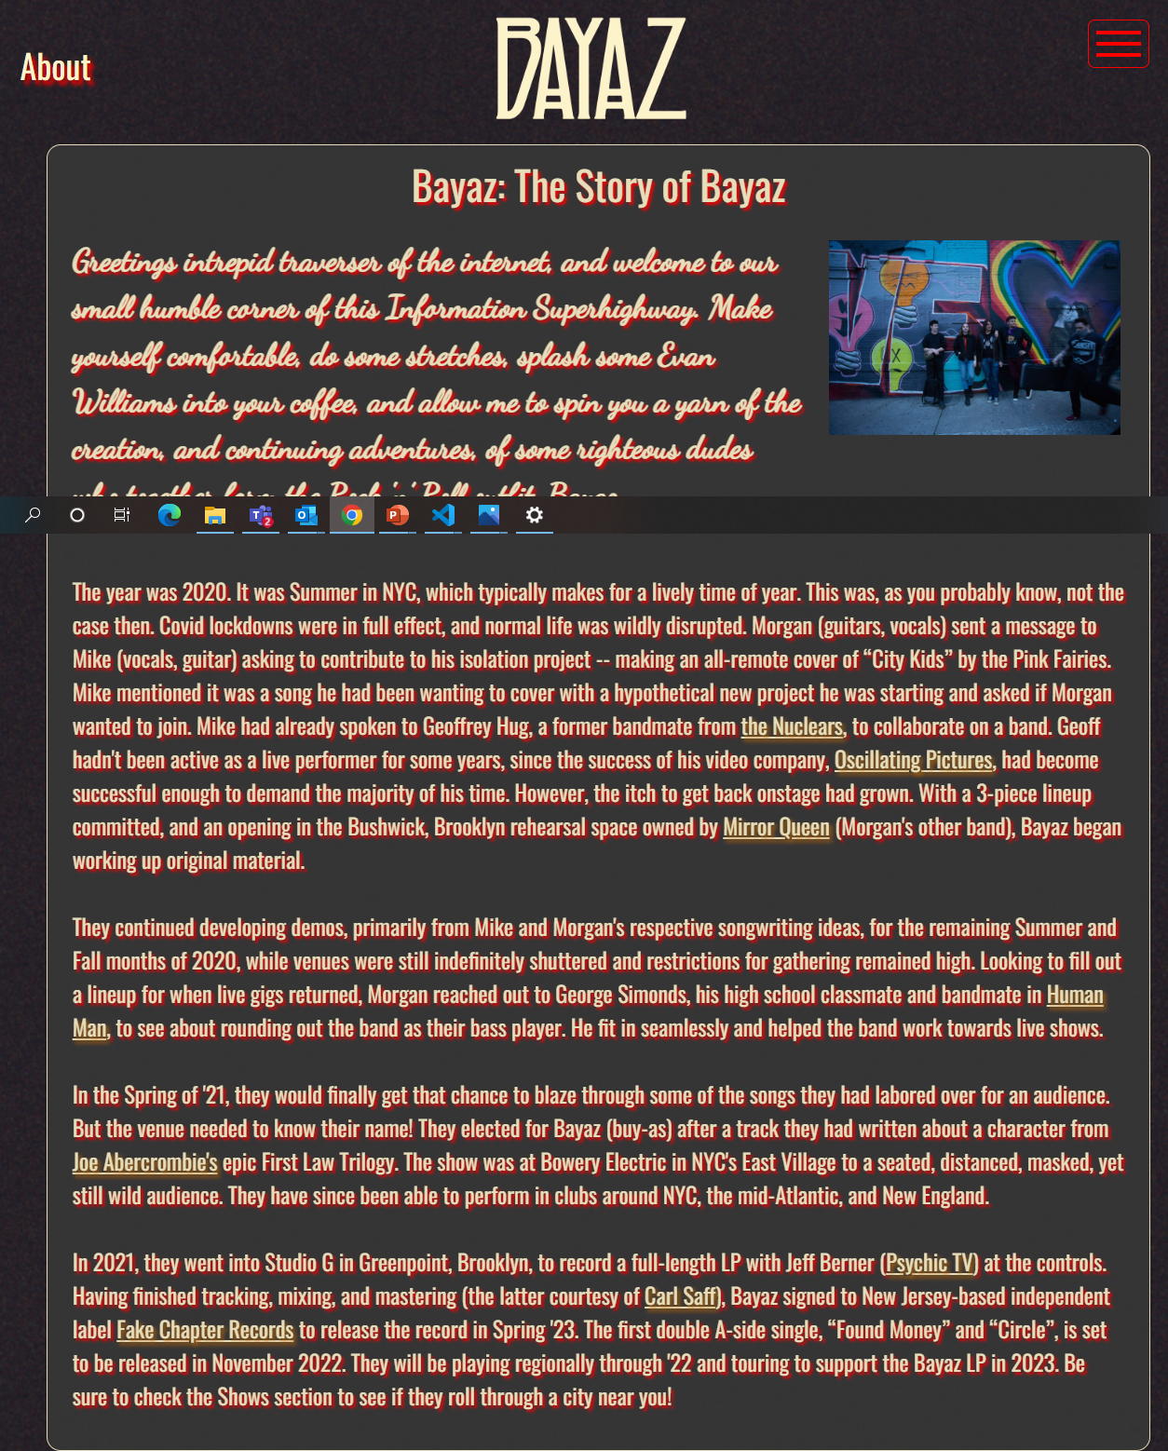
The Next Steps…
Finalize email form to forward to band’s email
Replace mock data (music & videos) w/ current Bayaz material
Create cards introducing the band members in ‘About’ section
Integrate a merchandise checkout
Render Instagram feed in ‘Gallery’

Slide 4
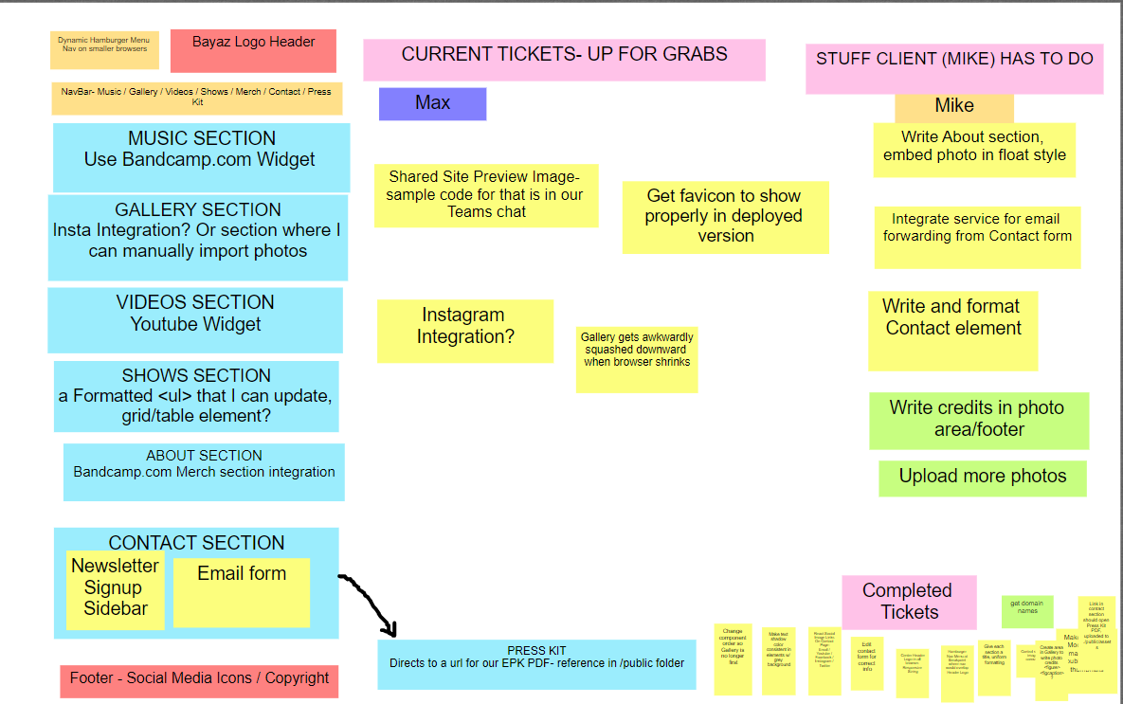
We created a Wireframe/Kanban Board on Whitespace as a single source of truth to reference for layout and features we needed to code.
Github provided source control. We tested features in a dev branch, then merged w/ production on completion. Netlify was config’ed to automatically reflect updates.
Our Process

Slide 5
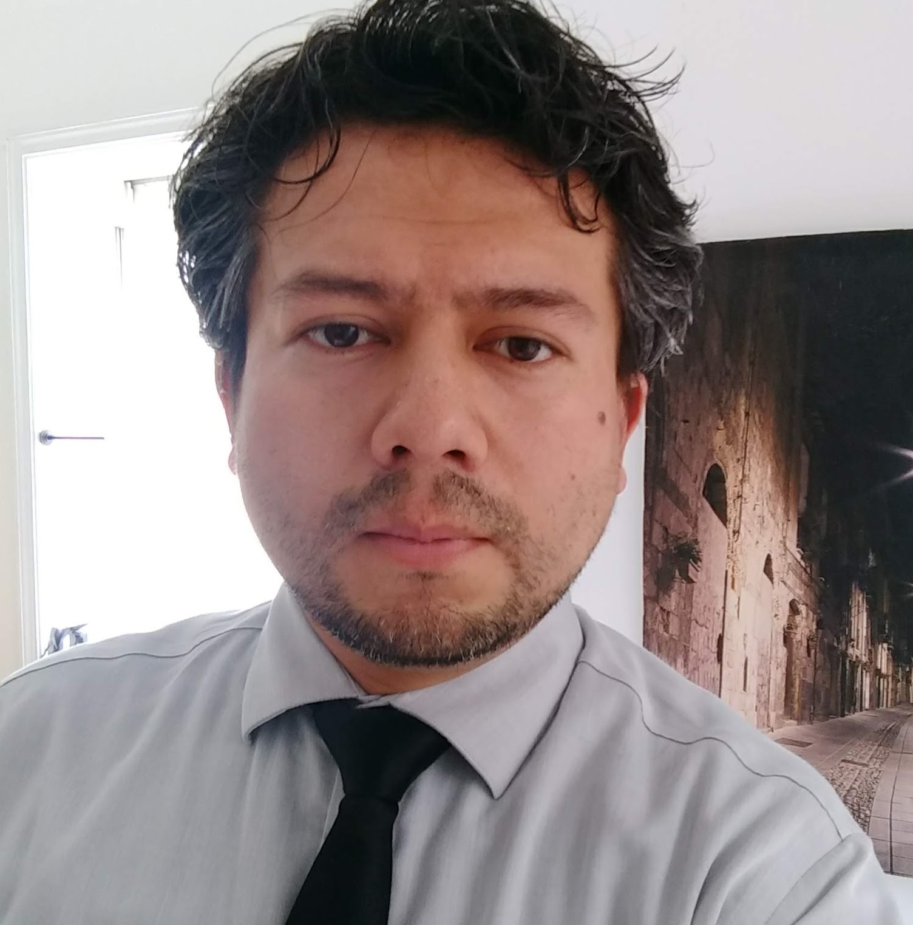
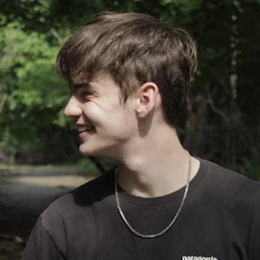
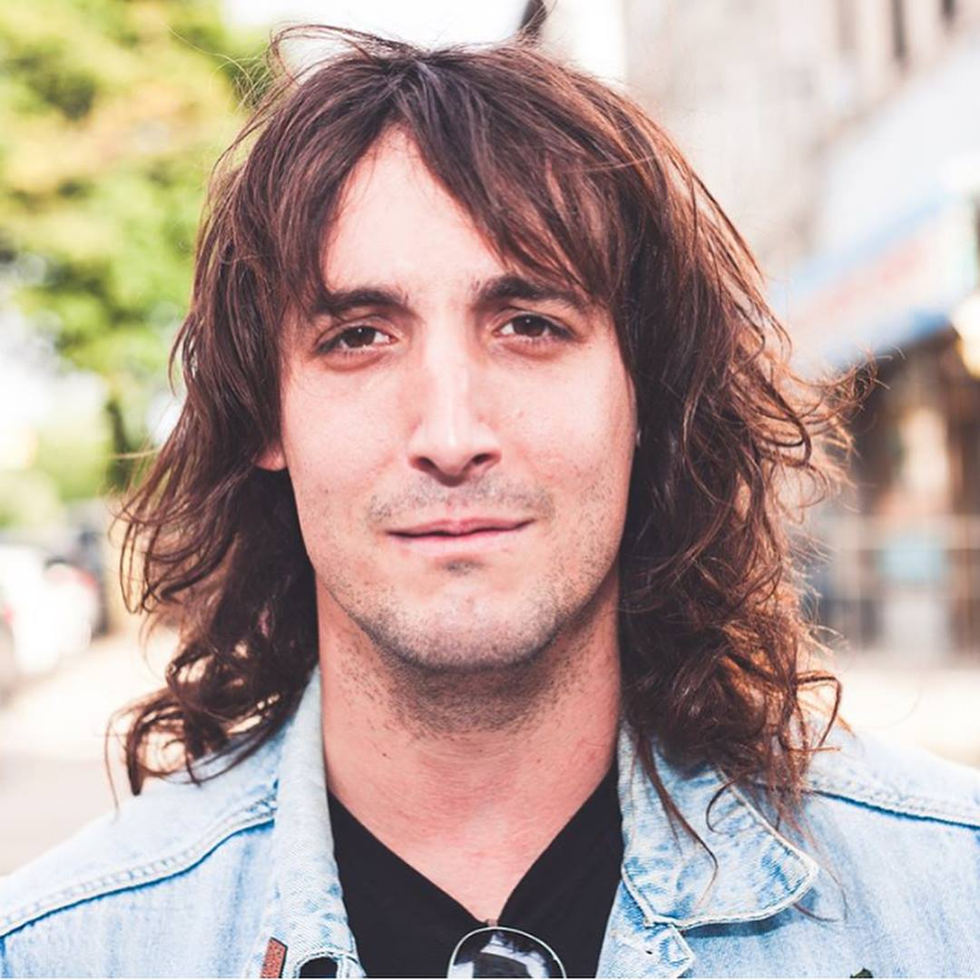
Meet “The Band”
Danny Vera
Senior Developer. Flexbox Hero. Problem Solver. React Wizard.
Max Rabin
Senior Developer, Master of React. Gentleman/Scholar.
Mike Dudolevitch
Product Owner, “Client”, Junior Developer. Singer/Guitarist/Songwriter of Bayaz.

